Slide 1
Integration of Privacy and Security with NIST 800-53 Rev 5
Presented by Robin Burress
NOAA Privacy Act Officer
Office of the Chief Information Officer
NOAA Enterprise Data Division
April 27, 2023

Slide 2
Overview
Prerequisite to Authority to Operate (ATO)
Dept. of Commerce (DOC) Control Assessment Worksheets (CAW)
The PIA Process
Security Control Concurrence
Questions

Slide 3
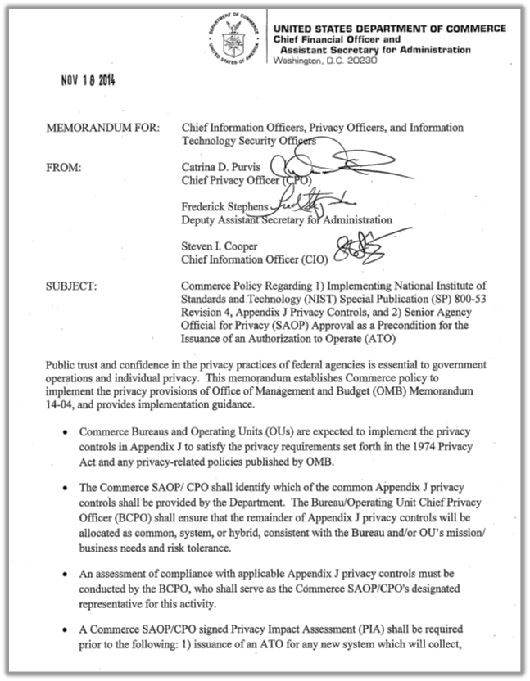
PIA Prerequisite to ATO
CIO
CPO
Deputy Assistant
Secretary for Administration
Senior Agency Official for
Privacy (SAOP)
Notes:
In 2014, soon after the issuance of NIST 800-53 Rev. 4, the Chief Information Officer, Chief Privacy Officer, and Deputy Assistant Secretary for Administration issued a Memo throughout the Department that made Authority to Operate issuance dependent on an Senior Agency Official for Privacy approved PIA.

Slide 4
PIA Prerequisite to ATO
Department’s foresight
Security and Privacy Controls
ATO
Notes:
The Department recognized well in advance of Rev. 5 that both the Security as well as the Privacy Controls were essential in order to be issued an authorization to operate a FISMA System.

Slide 5
PIA Prerequisite to ATO
Approximately 4.2 million employees data stolen
NIST Standards became essential
Paved the way for integration with Security Controls Rev. 5
Notes:
The Memorandum came less than one year before the Office of Personnel Management discovered that the personnel data of approximately 4.2 million current and former Federal government employees had been stolen. The NIST Standards, although newly issued, quickly became seen as essential for secure operation of a FISMA System, which paved the way for their integration with Security Controls in Rev. 5.

Slide 6
DOC Control Assessment Worksheets
Privacy Controls and Security Controls integrated into a single worksheet
Notes:
In order for a PIA to be reviewed, DOC has integrated the Privacy Controls and Security Controls into a single, adaptable worksheet. This allows for assessment of the Privacy Controls and the impact of each control on the overall assessment of the Privacy impact of a FISMA System.

Slide 7
DOC Control Assessment Worksheets
800-122 PII Confidentiality Impact Rating: |  |  | High
Control | 800-122 Control | 800-53 J Control | Low | Moderate | High | Mod to High Jump | System Implementation | Notes and Findings
AC-1 |  |  | X | X | X |  | Implemented
AC-2 |  |  | X | X | X |  | Implemented
AC-2(8) |  |  |  | -- | -- |  | Not Applicable
AC-2(9) |  |  |  | * | * |  | Not Applicable
AC-2(13) |  |  | X | X | X |  | Implemented
AC-3 | X |  | X | X | X |  | Implemented
AC-3(9) | * |  |  | X | X |  | Not Applicable
AC-3(10) | * |  |  | * | * |  | Not Applicable
AC-4 | * |  |  | X | X |  | Implemented
AC-4(8) |  |  |  |  | X | * | Not Applicable
AC-4(15) |  |  |  | X | X |  | Not Applicable
AC-4(17) |  |  |  | X | X |  | Not Applicable
AC-4(18) |  |  |  | X | X |  | Not Applicable
AC-5 | X |  |  | X | X |  | Implemented
AC-6 | X |  |  | X | X |  | Implemented
AC-6(1) | * |  |  |  | X | * | Implemented
AC-6(2) | * |  |  | X | X |  | Not Implemented - Risk Accepted | This FISMA System’s use cases with escalated privilege do not comprehensively meet the control objective due to technical limitations with native vendor authentication solutions, which have been documented within an AOR ratified by the System Owner, NOAA IT Security Officer and Authorization Official.
AC-6(3) | * |  |  |  | * |  | Implemented
AC-6(5) | * |  |  |  | X |  | Implemented
AC-6(7) | * |  | X | X | X |  | Not Applicable
AC-6(9) | * |  |  | X | X |  | Implemented
AC-6(10) | * |  |  | X | X |  | Implemented
AC-8 |  |  |  | * | * |  | Not Implemented - Risk Accepted | This FISMA System’s assets are unable to comprehensively meet the control objective due to technical limitations as a result the System Owner, IT Security Officer and Authorizing Official have approved an AOR to supplement the compliance gap.
Notes:
Notice the crosswalk of each of the privileges, whether it is a Privacy control, whether it is applicable to this particular system, and whether or not there has been a risk acceptance, POA&M to address a deficiency, or whether the control has been implemented.

Slide 8
DOC Control Assessment Worksheets
The structure of the CAW allows for:
An examination of how Security Control failures impact the Privacy of a system
A determination of how Privacy Control failures may impact the Security of a System
When Privacy overlay is necessary
Notes:
The structure of the CAW allows for an examination of how Security Control failures impact the Privacy of a System, how Privacy Control failures may impact the Security of the System, and when Privacy overlay is necessary due to either an acceptance of risk, POA&M, or heightened need for Privacy protection given a particular data set in a FISMA System’s accreditation boundaries.

Slide 9
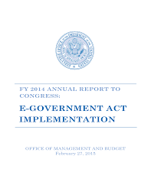
The PIA Process
Section 208 of the E-Government Act of 2002
OMB Circular A-130
Notes:
There have been specific assessment Privacy controls since 2002. Section 208 of the E-Government Act outlines the need for the PIA. Also, OMB Circular A-130 required a structure for managing information as a strategic resource. In 2016, OMB revised Circular A-130, to reflect changes in law and advances in technology. The revisions also ensured consistency with executive orders, presidential directives, OMB policy, and National Institute of Standards and Technology standards and guidelines.
The Circular establishes general policy for information governance, acquisitions, records management, open data, workforce, security, and privacy. It also emphasizes the role of both privacy and security in the Federal information life cycle. Importantly, it represents a shift from viewing security and privacy requirements as compliance exercises to understanding security and privacy as crucial elements of a comprehensive, strategic, and continuous risk-based program at Federal agencies.

Slide 10
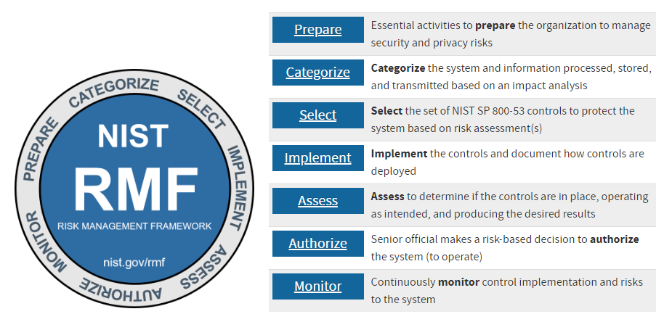
The PIA Process
Notes:
Although conducting a PIA was not integrated into the Security Control process, the controls themselves were previously identified as being “privacy controls”, including within the NIST 800-53 framework as the Appendix J controls.
Under the Rev. 4 framework, the PIA itself serves as a required governance document under AR-1, and the genesis of the authority to collect under AP-1 and AP-2 within Appendix J.

Slide 11
The PIA Process
If any of the 26 Privacy Controls were not implemented
PIA analyzed the sufficiency of the controls
Privacy overlay to compensate for the deficiency
Compared against the Confidentiality Impact Level under NIST 800-122
NIST 800-122 can have a different rating than the FIPS standard
Notes:
If any of the 26 Privacy Controls were not implemented, partially implemented, or required a POA&M, the Privacy Impact assessment analyzed the sufficiency of the controls, or necessary privacy overlay to compensate for the deficiency, and compared against the confidentiality impact level of the PII being collected under NIST 800-122.
It is important to note that the Confidentiality Impact Level under NIST 800-122 can have a different rating than the FIPS standard. In fact, the NIST 800-122 level can be High, and yet reside in a FIPS Moderate System. Similarly, the NIST 800-122 confidentiality Impact Level can be a moderate, and yet reside in a FIPS High system. In the former, however, Privacy Overlays are needed to further protect the Privacy data within the FIPS Moderate System.

Slide 12
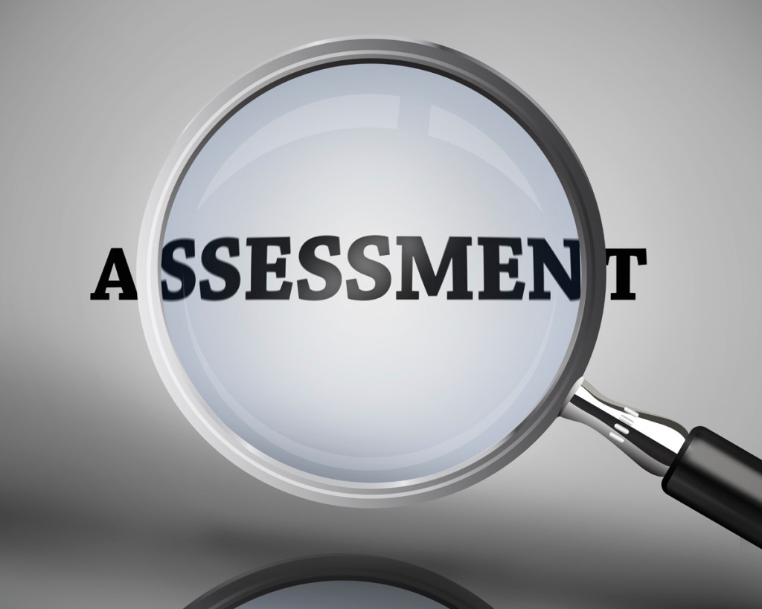
The PIA Process
Annual assessment of Privacy within each FISMA System
PTA
PIA
This Photo by Unknown Author is licensed under CC BY-NC-ND
Notes:
NOAA annually assesses the impact of the Privacy within each of its FISMA Systems. This is a two-step process, beginning with a Privacy Threshold Analysis, followed by a Privacy Impact Assessment.
The PTA is a baseline determination of whether or not PII exists within the system. If so, then a PIA must be completed each year to analyze the impact, controls, use, notice, consent, and statutory compliance associated with that collection.

Slide 13
Security Control Concurrence
CIO representation in the PIA Compliance Review boards to identify security control considerations during Privacy Control review
Security
Privacy
Notes:
Several years ago, as the first drafts of Rev. 5 were being circulated, the Department of Commerce identified the need to integrate Security and Privacy Control reviews. This resulted in CIO representation in the PIA Compliance Review boards to identify security control considerations during Privacy Control review.

Slide 14
Security Control Concurrence
Identifying security control consideration now delegated to the Bureaus
NOAA’s CIO conducts a Security Control concurrence review
Focused specifically to determine the security posture of a FISMA system
Notes:
Identifying security control considerations during Privacy Control review has since been delegated to the Bureaus. Separately from any ATO process or IT Security Control Review—NOAA’s CIO personally conducts a Security Control concurrence review, for all FISMA Systems collecting PII within NOAA.
This review is focused specifically to determine the net security posture of a FISMA System through the lens of the impact to privacy, including residual risk, changes to the Privacy risk posture year over year, and any POA&Ms or Privacy Control deficiencies.

Slide 15
QUESTIONS

