Slide 1
OPOG FOIA FY 2024 Priorities
Nicholas J. Cormier
Deputy Program Director for Departmental FOIA/PA
and Open Government Operations
NCormier@doc.gov | eFOIA@doc.gov
Phone: 202-482-7817

Slide 2
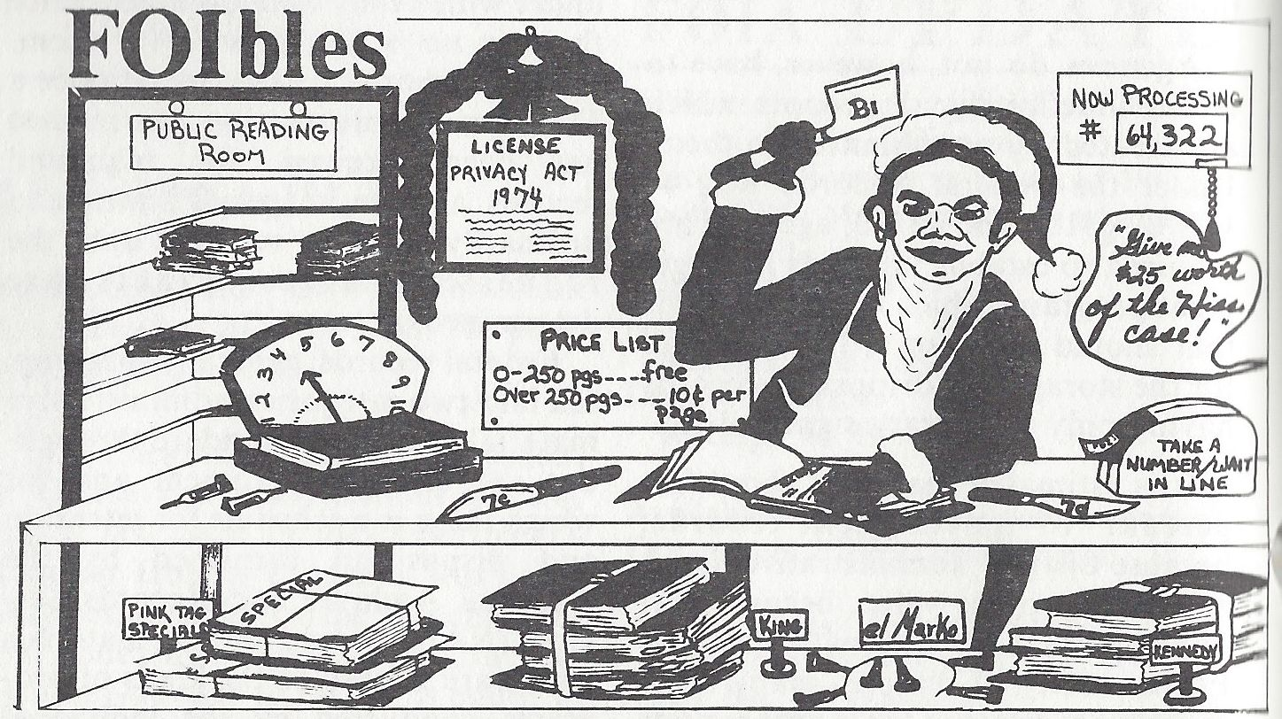
Early FOIA Processing
Source: U.S. Department of Justice, FOIA Update, Vol III, No 1, December 1981. Unsigned

Slide 3
OPOG FOIA FY 2024 Priorities
Identify Opportunities to Leverage Artificial Intelligence & eDiscovery Solutions and Platforms

Slide 4
OPOG FOIA FY 2024 Priorities
Identify Opportunities to Leverage Artificial Intelligence & eDiscovery Solutions and Platforms
Update the Department’s FOIA & Privacy Act Regulations

Slide 5
OPOG FOIA FY 2024 Priorities
Identify Opportunities to Leverage Artificial Intelligence & eDiscovery Solutions and Platforms
Update the Department’s FOIA & Privacy Act Regulations
Reduce the Department’s FOIA Backlog

Slide 6
OPOG FOIA FY 2024 Priorities
Identify Opportunities to Leverage Artificial Intelligence & eDiscovery Solutions and Platforms
Update the Department’s FOIA & Privacy Act Regulations
Reduce the Department’s FOIA Backlog
Chief FOIA Officer Report & Annual and Quarterly FOIA Reports

Slide 7
Contact Us
Nick Cormier
Deputy Program Director for Departmental FOIA/PA and Open Government Operations
NCormier@doc.gov | eFOIA@doc.gov
Phone: 202-482-7817
Bobbie Parsons
IOS FOIA Officer BParsons@doc.gov
Kietta Lockerman
Government Information Specialist KLockerman@doc.gov
Tonya Johnson
Government Information Specialist TJohnson4@doc.gov

