Slide 1
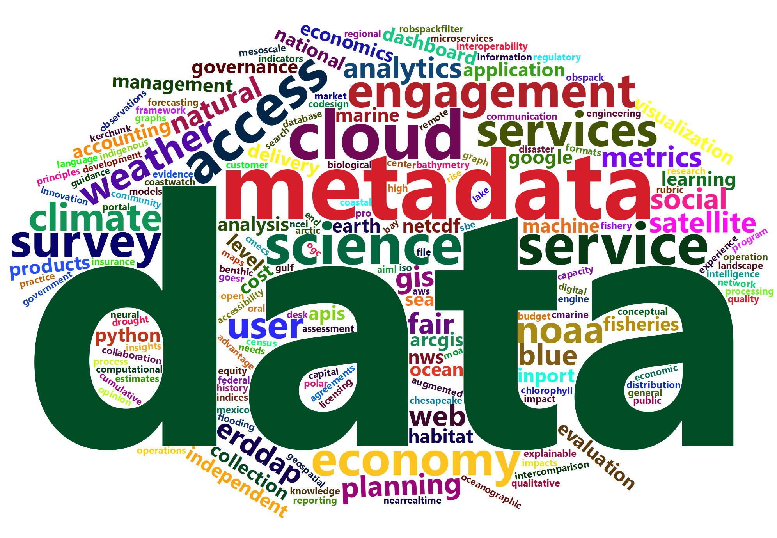
NOAA Data
Tony LaVoi
NOAA Chief Data Officer
May 7, 2024

Slide 2
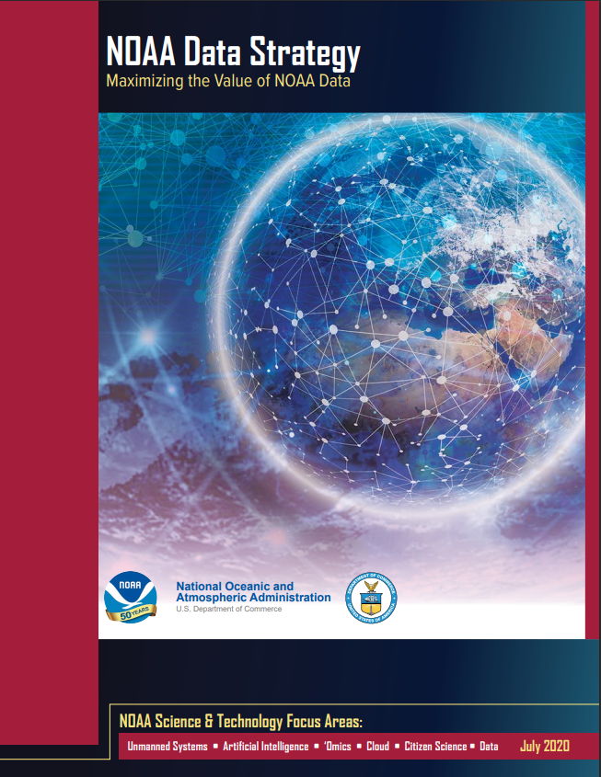
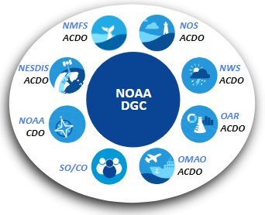
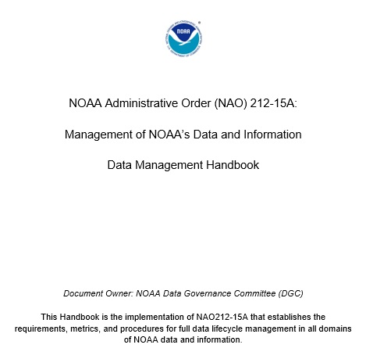
Enhancing Access to NOAA’s Open Data
The purpose of the NOAA Data Strategy is to dramatically accelerate the use of data across the agency and with other key partners, maximize openness and transparency, deliver on mission, and steward resources while protecting quality, integrity, security, privacy, and confidentiality.
NOAA Data Strategy
NOAA Data Governance Committee (DGC)
NOAA Data Management Handbook
NOAA Data Community Intranet Site

Slide 3
NOAA CDO Framework
Foundations for Evidence-Based Policymaking Act of 2018 (Evidence Act) directed federal agencies to appoint a Chief Data Officer (CDO) and take specific actions for improving access to high-quality government data, with the goal to enhance decision-making about important programs and the availability of open data for the American people
Organizationally placed the CDO within the Office of the Chief Information Officer - report to NOAA CIO
Goal to align NOAA’s Open Government and Open Data requirements and programs at the enterprise and line office levels

Slide 4
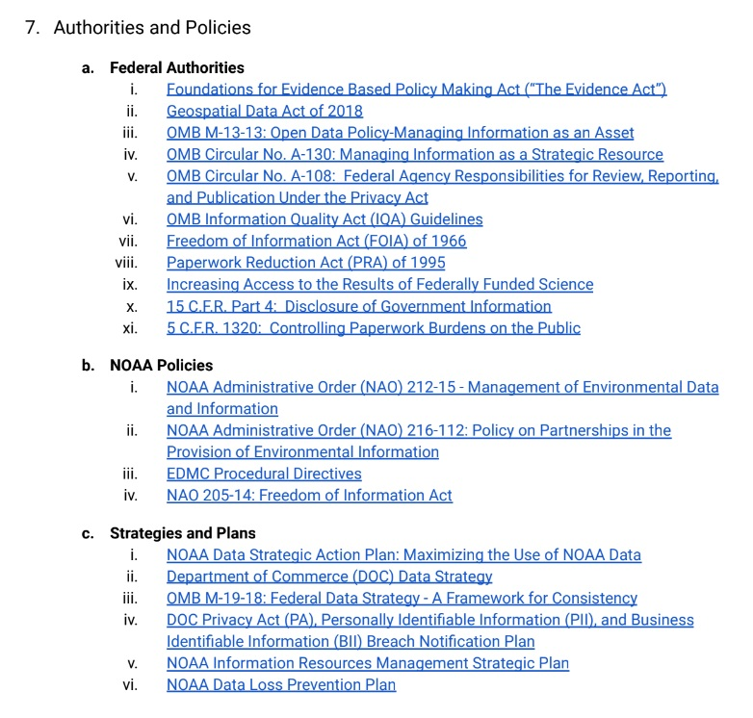
Where FOIA Fits?
OCIO/NOAA Enterprise Data Division
Government Information Services Program
Freedom of Information Act (FOIA)
Privacy Act of 1974
Paperwork Reduction Act (PRA)
Information Quality Act (IQA)
FOIA liaisons collaborative approach is a model for other NOAA data and information service areas
Impressed with commitment to learning and information sharing among the FOIA community
Recognition of the tremendous effort to successfully migrate to FOIAXpress

